Slide 1
RIN Review
December 30th 2018

Slide 2

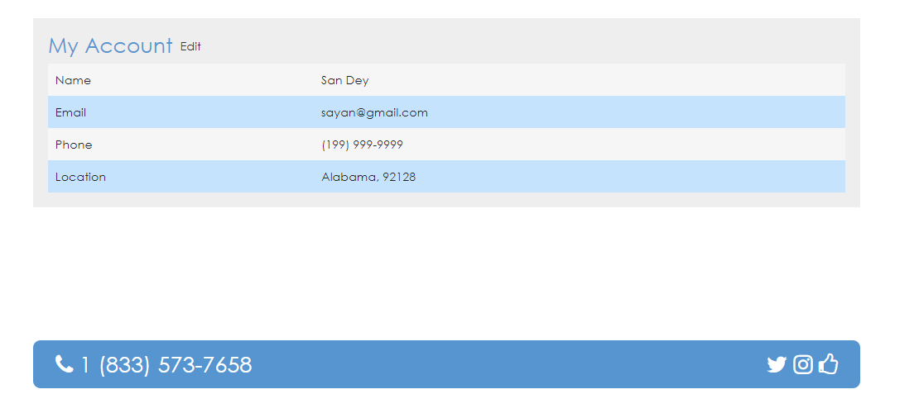
Global Changes
White space between content and bottom bar is too big
Background of logo and page do not match

Slide 3
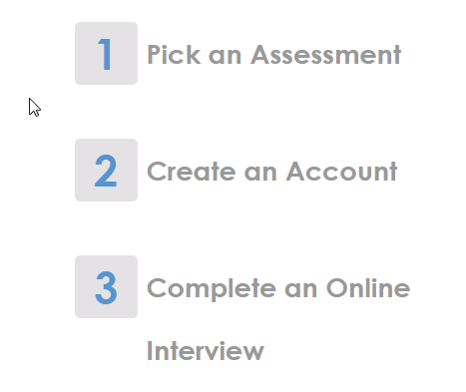

homepage
Close the gap

Slide 4
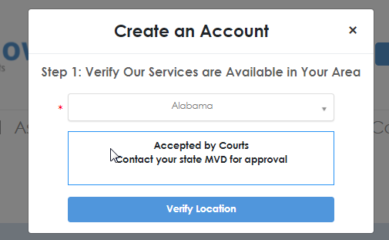
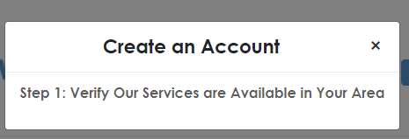
Create Account
Create account not working, freezes on one of these screens

Slide 5
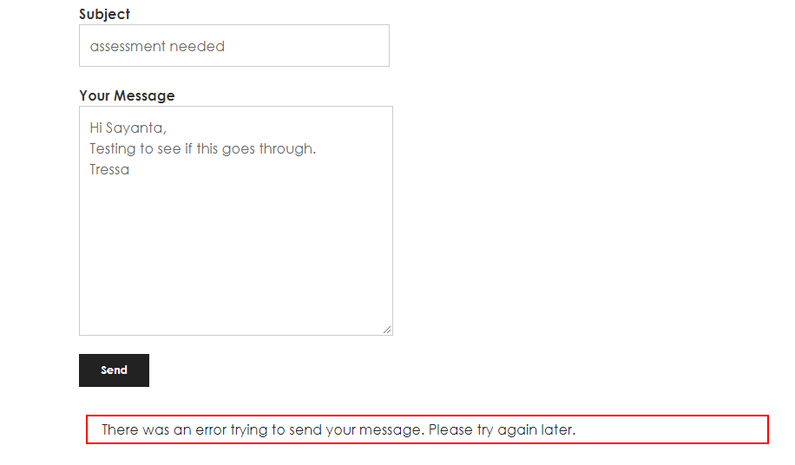
Assessments Page
Staff Page
Header font does not match content font
Add email address: counselor@drugsandalcoholassessment.com
Header font does not match content font
Email address: info@drugsandalcoholassessment.com
Phone number: 1-833- 573-7658
Courts Page
All of these have no content
Header font does not match content font
Phone number: 1-833- 573-7658
Contact Us Page
Header font does not match content font
Error message not consistent with specs – what is the standard display for errors? Some pop up under, some to the top right, some under field.

Slide 6
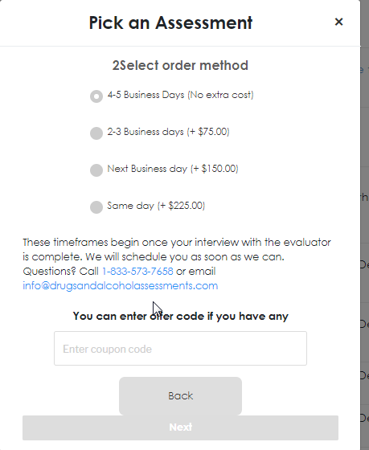
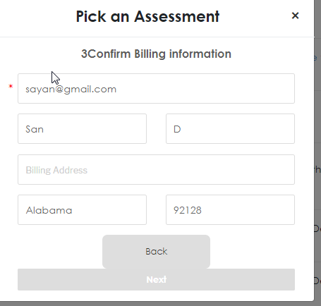
Pick an Assessment
Buttons are grey and Next is huge!
Numbers run into title

Slide 7
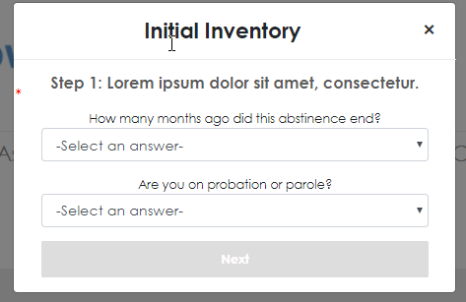
Initial Inventory
Questions are not in the right order
Step 2: Complete questionnaire
1. Was this assessment prompted or suggested by the criminal justice system?
2. Are you presently awaiting charges, trial or sentence?
3. Are you on probation or parole?
4. Are you taking any prescribed medication on a regular basis for a physical problem?
5. What type of drug or alcohol do you consider a problem?
6. How long was your last period of voluntary abstinence from your major substance?
7. How many months ago did this abstinence end?
8. How many times have you overdosed on drugs?
9. How many times have you had Alcohol Delirium Tremens?
10. Have many times in your life have you been hospitalized for medical problems?
11. How many days have you experienced employment problems in the past 30 days?
12. How important to you now is counseling for these employment problems?

Slide 8
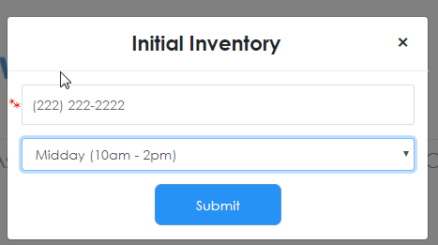
Schedule Online Interview
User has already completed the initial inventory.
Change title to Schedule an Online Interview

